Slide 1
Next generation sequencing analysis of microRNAs
Jessy Slota
PhD Student
Department of Medical Microbiology and Infectious Diseases, University of Manitoba, Winnipeg, Canada
Prion Diseases Section, National Microbiology Laboratory, Public Health Agency of Canada
jessy.slota@phac-aspc.gc.ca; slotaj@myumanitoba.ca

Slide 2
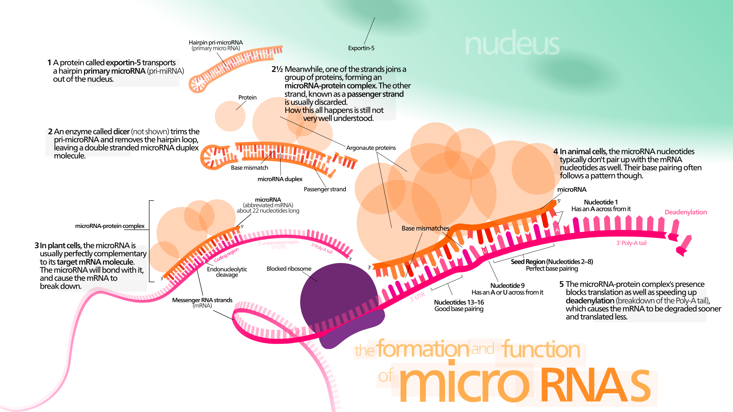
Micro-RNAs (miRNAs)
Small, non-coding RNAs
~22 nt in length
Regulate gene expression through RISC
Found in circulating fluids
Bartel, David P. Cell vol. 173,1 (2018): 20-51. doi:10.1016/j.cell.2018.03.006
By Kelvinsong - Own work, CC BY 3.0, https://commons.wikimedia.org/w/index.php?curid=23311105

Slide 3
Next generation sequencing (NGS)
Allows for high-throughput sequencing of DNA or RNA
Sequencing of RNA can be used to measure gene expression
Can also measure abundance of miRNAs through small-RNA sequencing
Why sequence miRNAs?
Global identification of miRNAs with altered abundance
Biomarker discovery
Combine with mRNA seq for miRNA-target identification

Slide 4
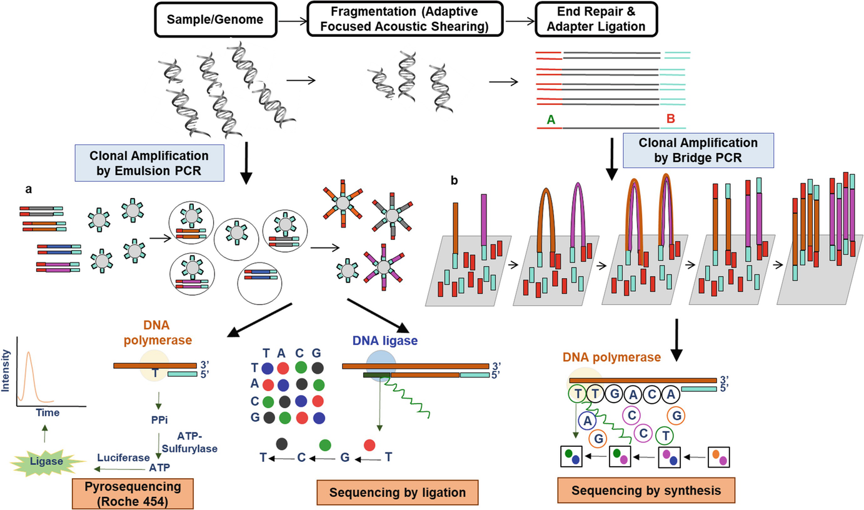
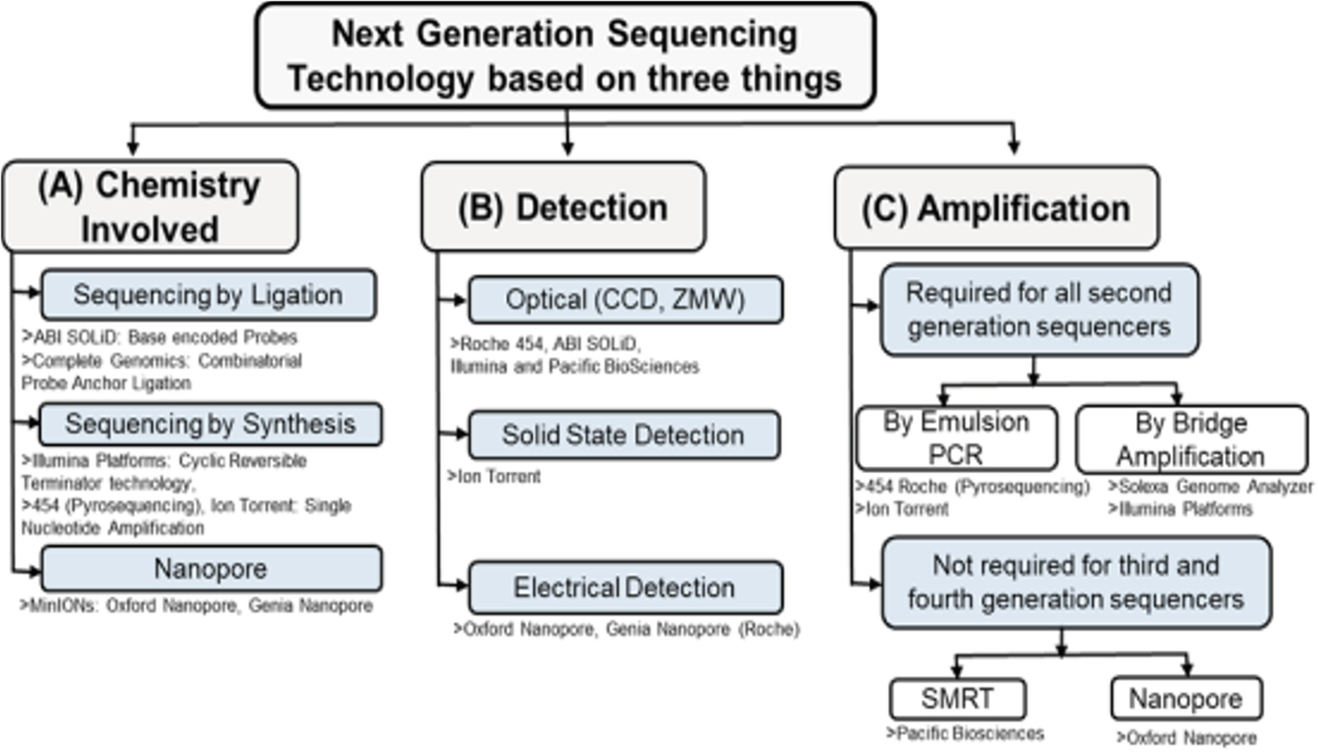
Next Generation Sequencing (NGS)
Gupta N., Verma V.K. (2019) Microorganisms for Sustainability, vol 17. Springer, Singapore. https://doi.org/10.1007/978-981-13-8844-6_15

Slide 5
NGS of miRNAs
RNA extraction… depends on tissue being used
E.g., TRIZol reagent, various kits for different types of tissues or biological fluids
Assess quality with Agilent Bioanalyzer
Library preparation
E.g., Illumina small RNA library preparation
Check quality of library on Agilent Bioanalyzer or TapeStation etc.
Library Fractionation (size selection 122–166 bp) with Pippin HT (SageScience)
Sequencing
E.g., Illumina NextSeq 500/550
usually performed by sequencing core
Primary output is raw `fastq` files
Kolanowska M., Kubiak A., Jażdżewski K., Wójcicka A. (2018) In: Ørom U. (eds) miRNA Biogenesis. Methods in Molecular Biology, vol 1823. Springer, New York, NY. https://doi-org.uml.idm.oclc.org/10.1007/978-1-4939-8624-8_8

Slide 6
NGS data analysis
“I have some data, now what?”
Different tools available… commercially available vs publicly available
The following tutorial will only use publicly available tools:
Pre-processing with Galaxy – mapping reads to miRNAs
Downstream analysis with R – statistics and data visualization (e.g., differential expression analysis)

Slide 7
Tutorial: basic NGS analysis of miRNAs
Part I: Preprocessing in Galaxy
Assessing sequencing read quality with FastQC
Removing sequencing adapters with Cutadapt
Cleaning sequencing reads with Trimmomatic
Aligning to reference genome with Bowtie2
Mapping reads to miRNAs and counting with FeatureCounts
Part II: Downstream Analysis with R
Raw reads count processing
Normalization and differential expression analysis with DESeq2
Examples of common data visualizations

Slide 8
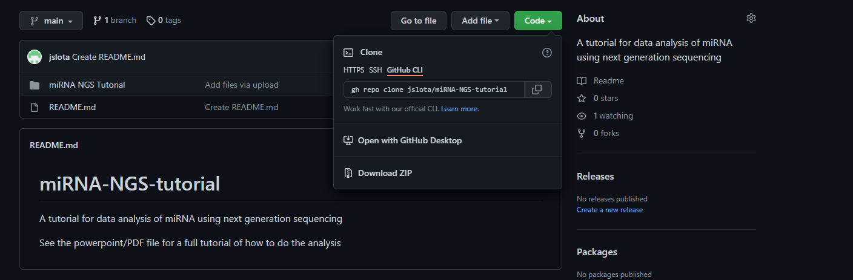
Getting started: download tutorial data directory
Find the tutorial at: https://github.com/jslota/miRNA-NGS-tutorial
Can manually download Zip file with all tutorial materials
Unzip to your preferred location to get folder with all materials

Slide 9
Part I: Pre-processing sequencing reads in Galaxy
Part I: Preprocessing in Galaxy
Downloading data from NCBI SRA
Assessing sequencing read quality with FastQC
Removing sequencing adapters with Cutadapt
Cleaning sequencing reads with Trimmomatic
Aligning to reference genome with Bowtie2
Mapping reads to miRNAs and counting with FeatureCounts
Download read count files (and re-upload as individual files)
Differential expression analysis with DESeq2 within Galaxy

Slide 10
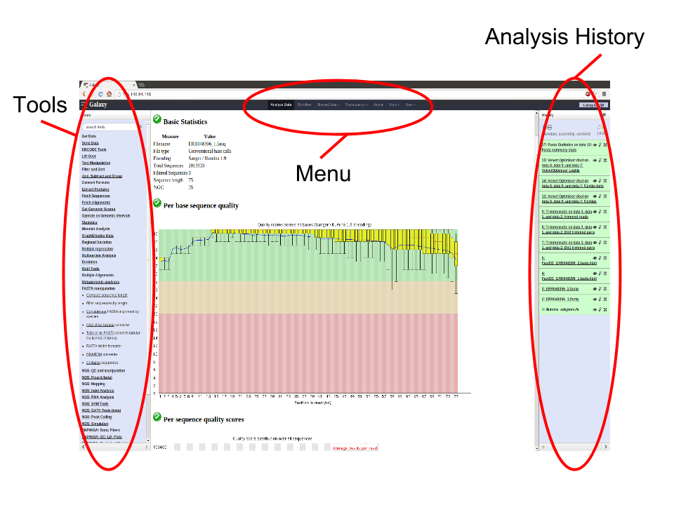
Galaxy platform
Publicly available
Different versions… can try free version online
Need to set up free account for this tutorial
Access at: https://usegalaxy.org/

Slide 11
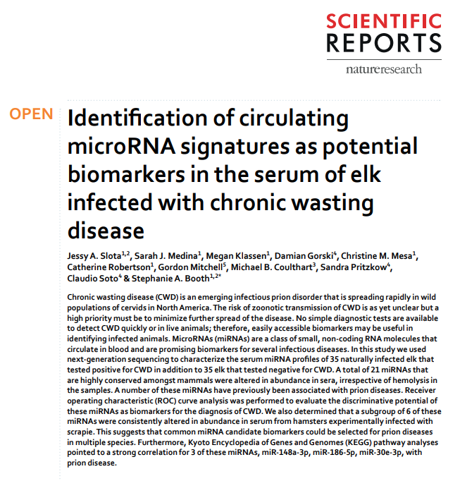
Step 1: Collect some data
We will use some of the data from this publication…
Slota, J.A., Medina, S.J., Klassen, M. et al. Sci Rep 9, 19705 (2019). https://doi.org/10.1038/s41598-019-56249-6

Slide 12
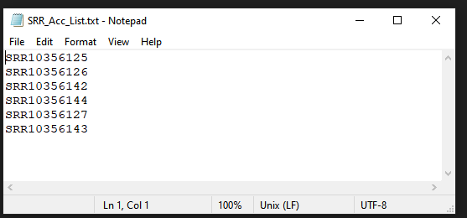
Step 1: Collect some data
Publicly available data from NCBI SRA (https://www.ncbi.nlm.nih.gov/sra)
Data will be imported into Galaxy using this list of SRA accession numbers that can be found in the downloaded tutorial directory

Slide 13
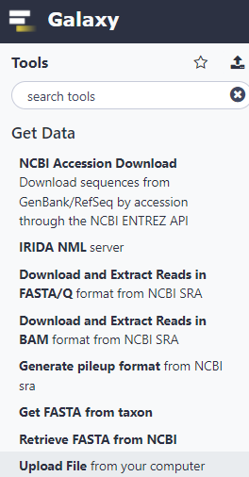
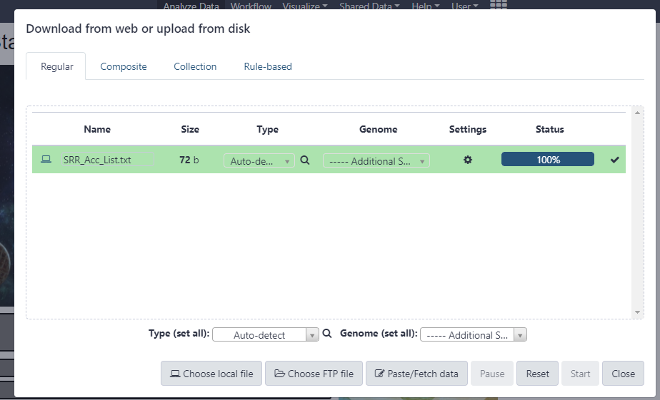
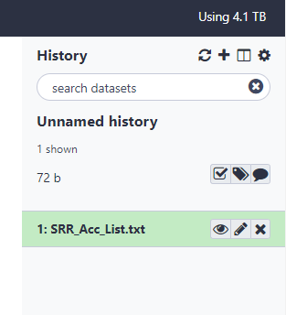
Step 1: Collect some data
Browse and select “SRR_Acc_List.txt” from wherever it is saved
Type “Upload file” into Tools search bar

Slide 14
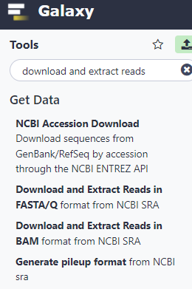
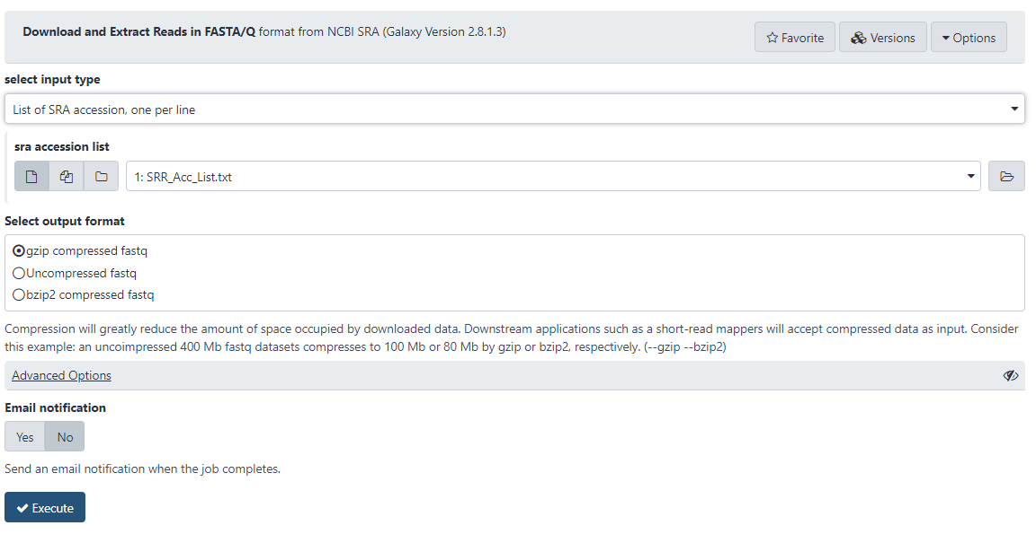
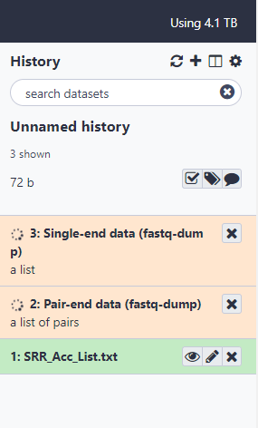
Step 1: Collect some data
Select “List of SRA accession…” from dop-down menu
Type “Download and Extract Reads in FASTA/Q” into tools search bar

Slide 15
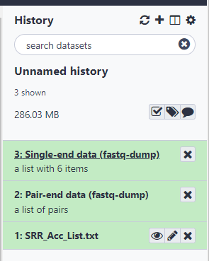
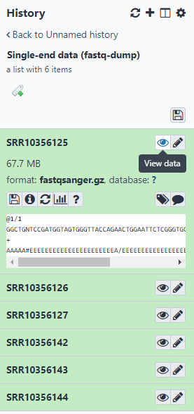
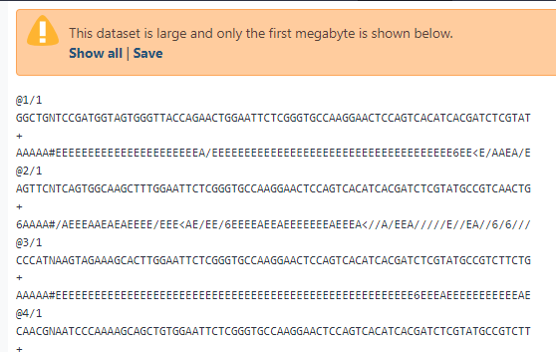
Step 1: Collect some data
Data is in the format of a collection
Click on the collection to examine individual datasets
Data is in Fastq format
Click “View data”

Slide 16
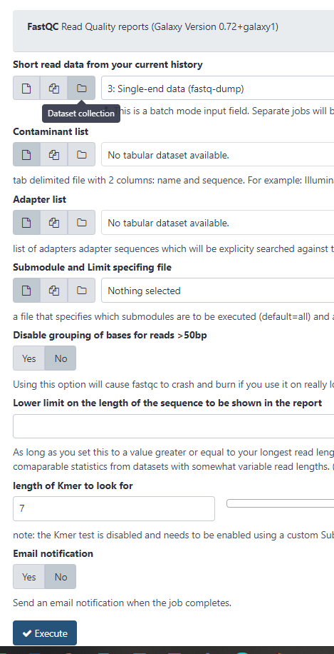
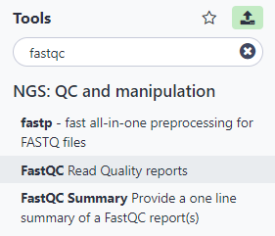
Step 2: Assess data quality with FastQC
Select “dataset collection” Icon
Then select “Single-end data…” from drop-down

Slide 17
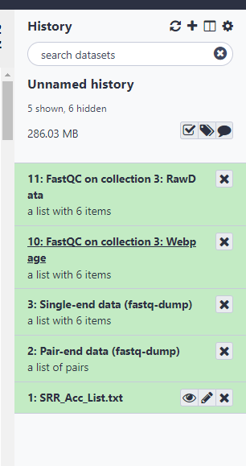
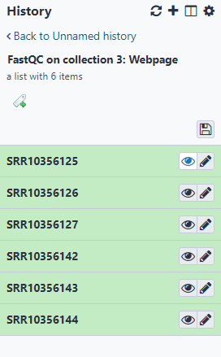
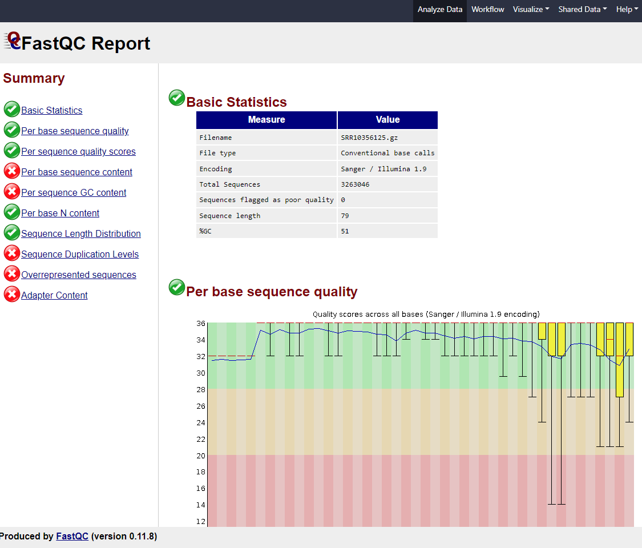
Step 2: Assess data quality
Click “View data”
Explore various quality reports…

Slide 18
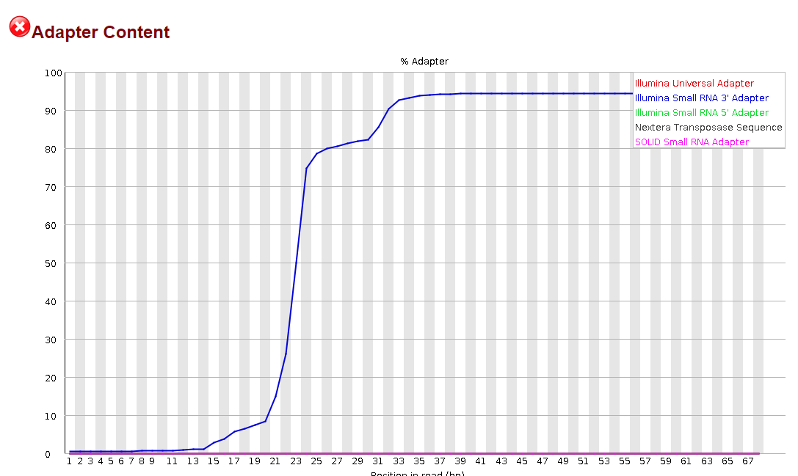
Step 2: Assess data quality
From FastQC results, we can see Illumina adapter contamination…

Slide 19
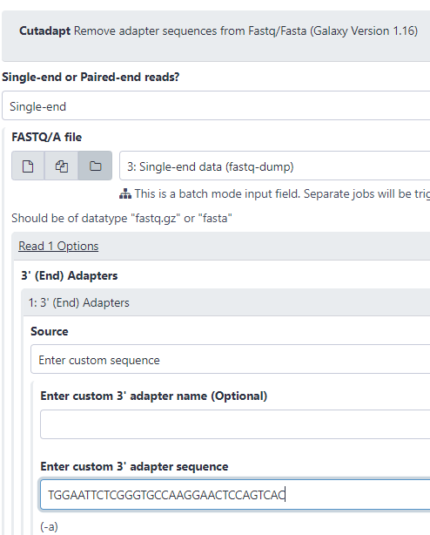
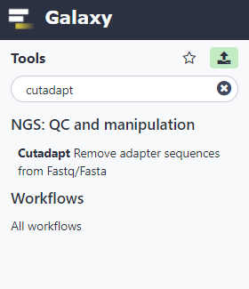
Step 3: Remove sequencing adapters with Cutadapt
Select “dataset collection” Icon
Then select “Single-end data..” from drop-down
Copy/paste the 3’ adapter sequence: TGGAATTCTCGGGTGCCAAGGAACTCCAGTCAC

Slide 20
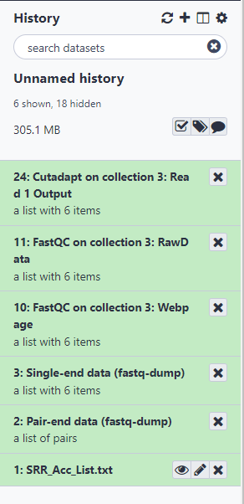
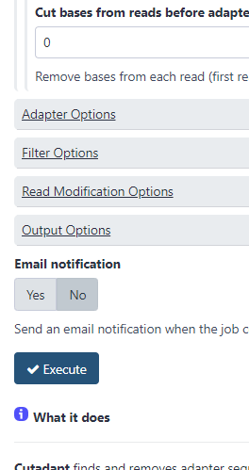
Step 3: Remove sequencing adapters with Cutadapt

Slide 21
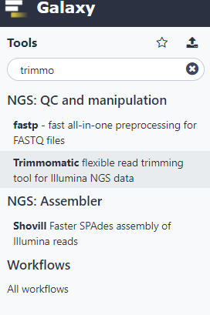
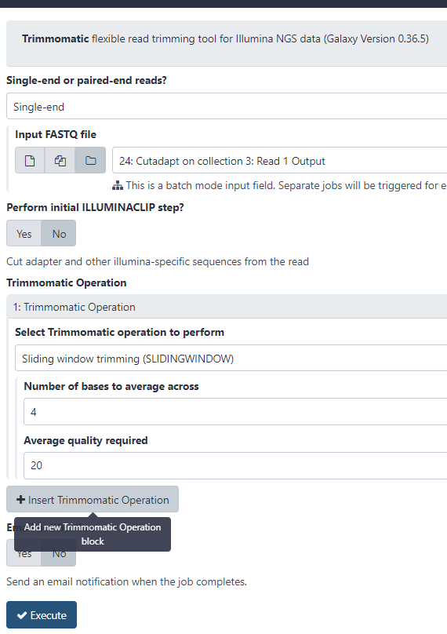
Step 4: Clean reads with Trimmomatic
Select “dataset collection” Icon
Then select “Cutadapt on collection…” from drop-down
Click “Insert Trimmomatic Operation” twice for a total of 3 “operations”

Slide 22
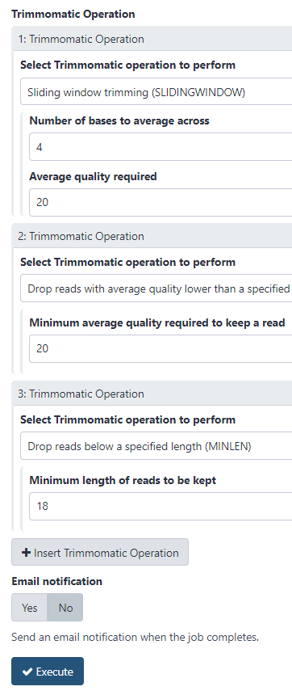
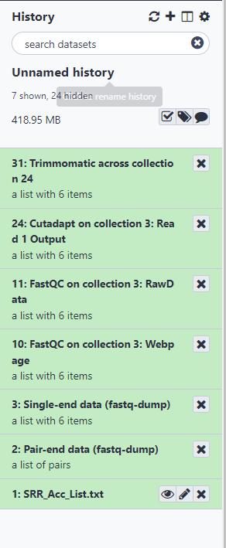
Step 4: Clean reads with Trimmomatic
1st operation – leave as defaults
2nd operation – “Drop reads with average quality…” Min average quality = 20
3rd operation – “Drop reads below length…” min length = 18
(How long should miRNA reads be?)

Slide 23
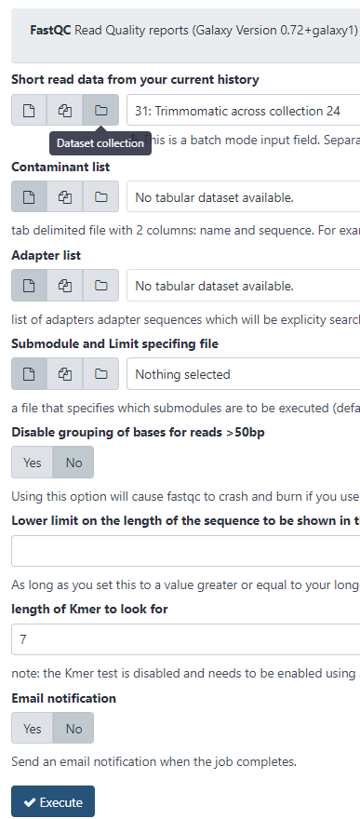
Step 4: Clean reads with Trimmomatic
Select “dataset collection” Icon
Then select “Trimmomatic across collection…” from drop-down
Use FastQC to check quality of cleaned reads (Same as Step 2)

Slide 24
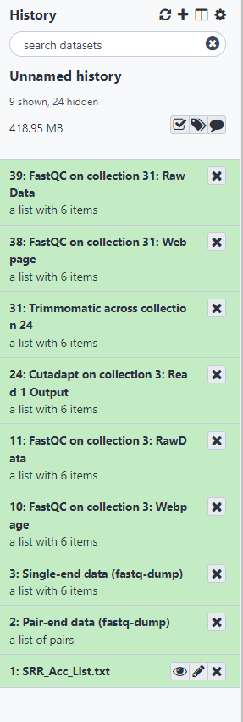
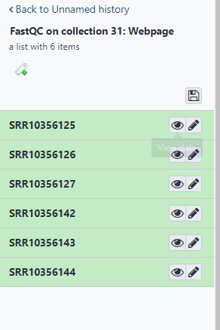
Step 4: Clean reads with Trimmomatic
Examine FastQC results as in step 2:

Slide 25
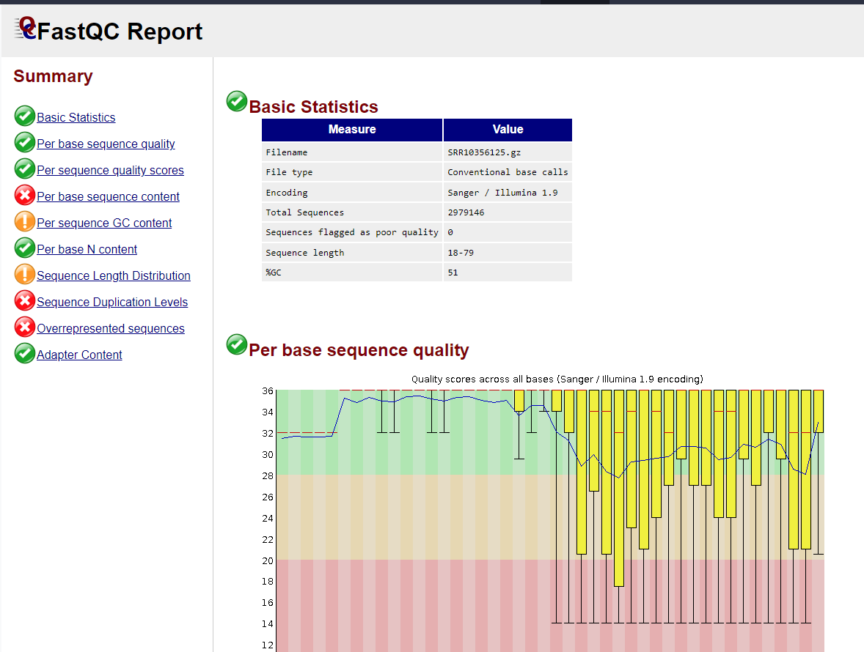
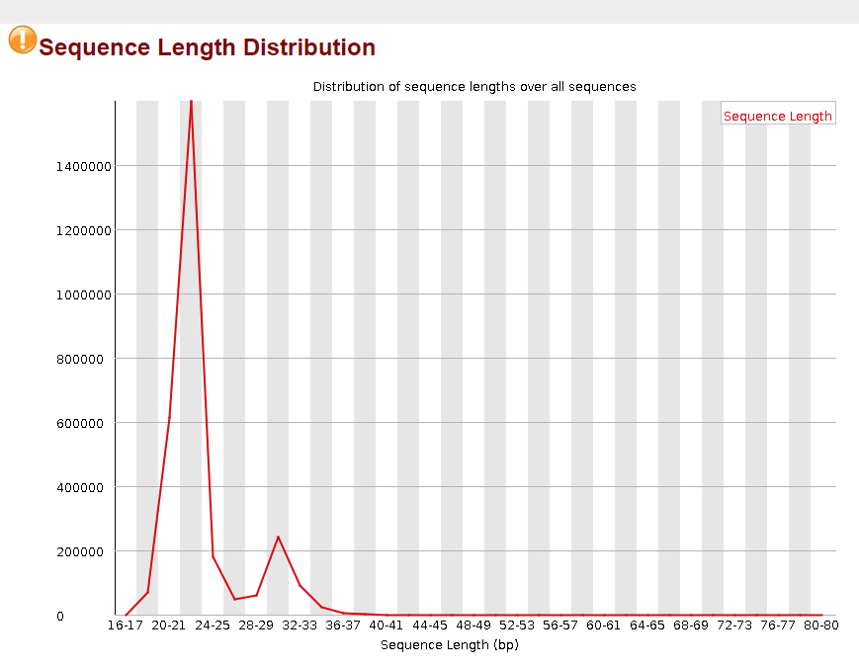
Step 4: Clean reads with Trimmomatic
Does the sequence length distribution make sense for miRNAs?

Slide 26
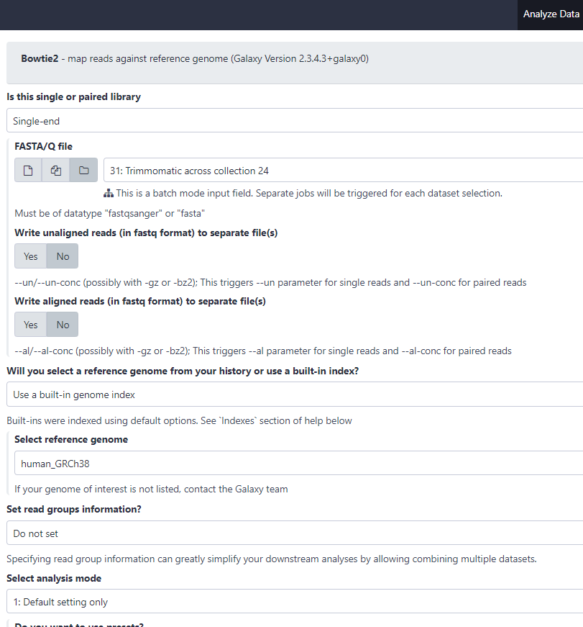
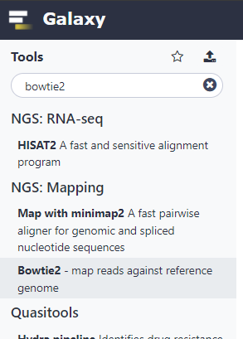
Step 5: Align to reference genome with Bowtie2
Select “dataset collection” Icon
Then select “Trimmomatic across collection…” from drop-down
Select “Built in genome index” and choose Human genome from dropdown
**Note, we are using human genome, because elk annotation is not available

Slide 27
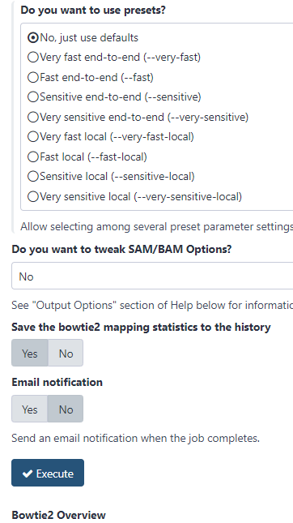
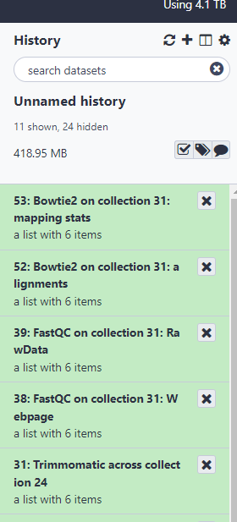
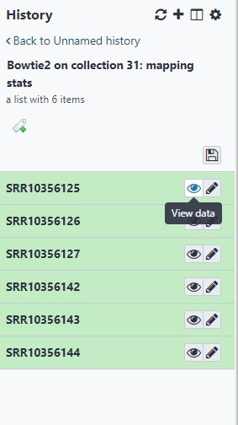
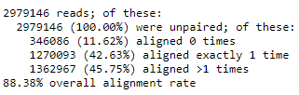
Step 5: Align to reference genome with Bowtie2
View mapping statistics… notice that there is a high level of multi-mapped reads
(Does this make sense for miRNAs?)

Slide 28
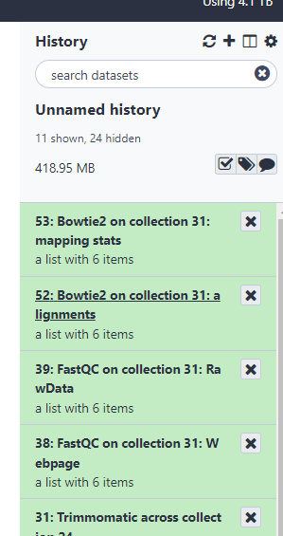
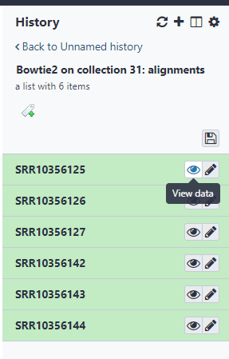
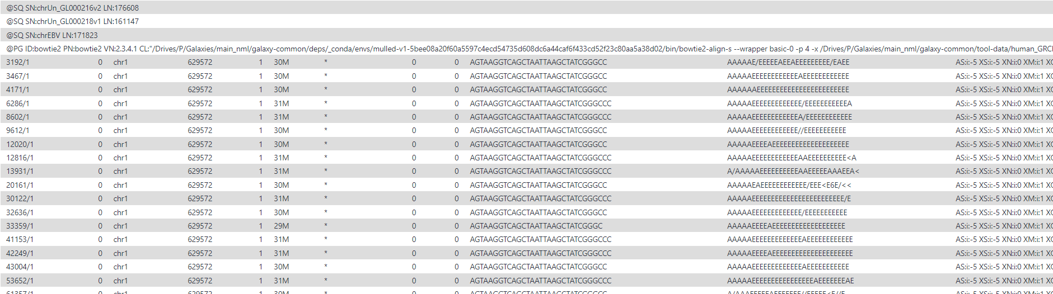
Step 5: Align to reference genome with Bowtie2
View alignment file in “BAM” format

Slide 29
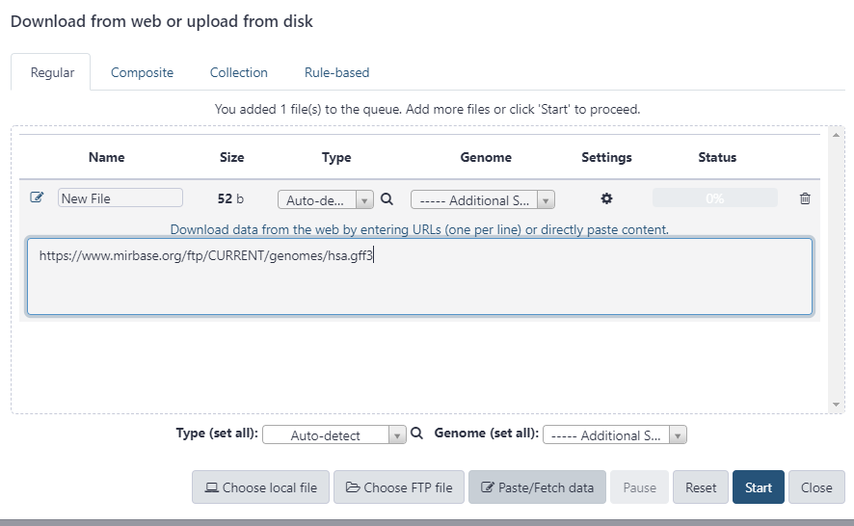
Step 6: Map and count miRNA reads with FeatureCounts
Copy/paste the following URL:
https://www.mirbase.org/ftp/CURRENT/genomes/hsa.gff3
Upload reference annotation file in GFF format

Slide 30
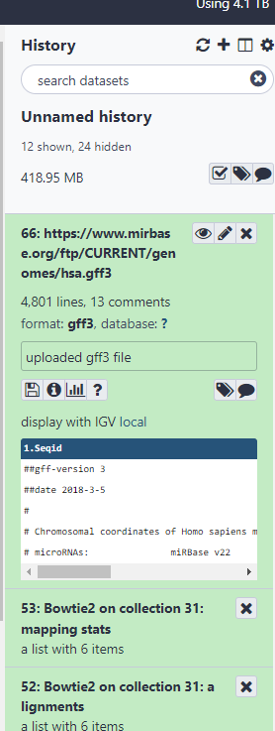
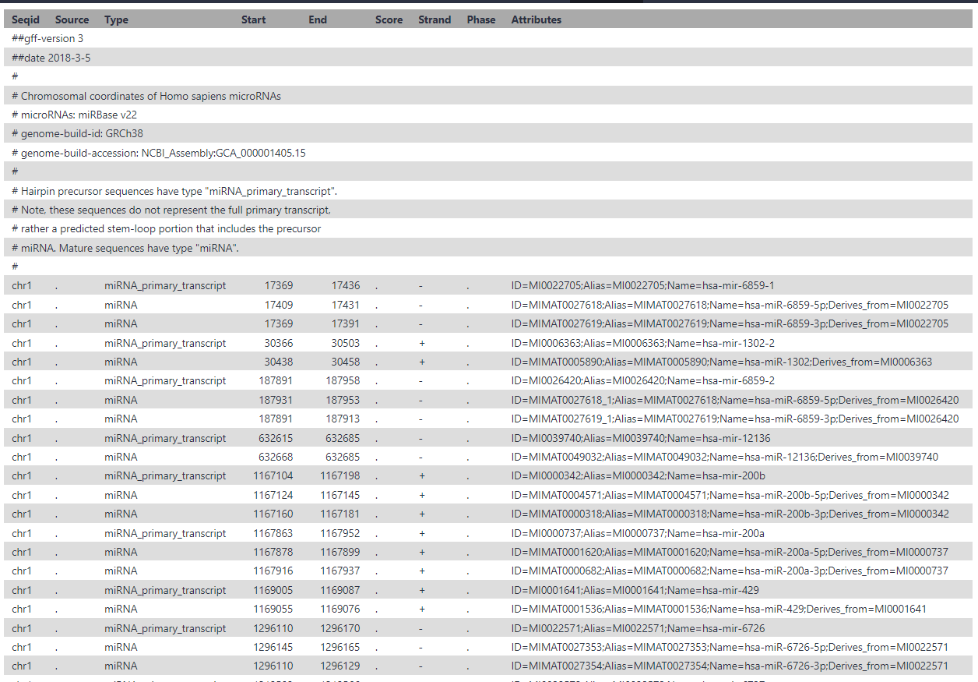
Step 6: Map and count miRNA reads with FeatureCounts
View annotation file in GFF format

Slide 31
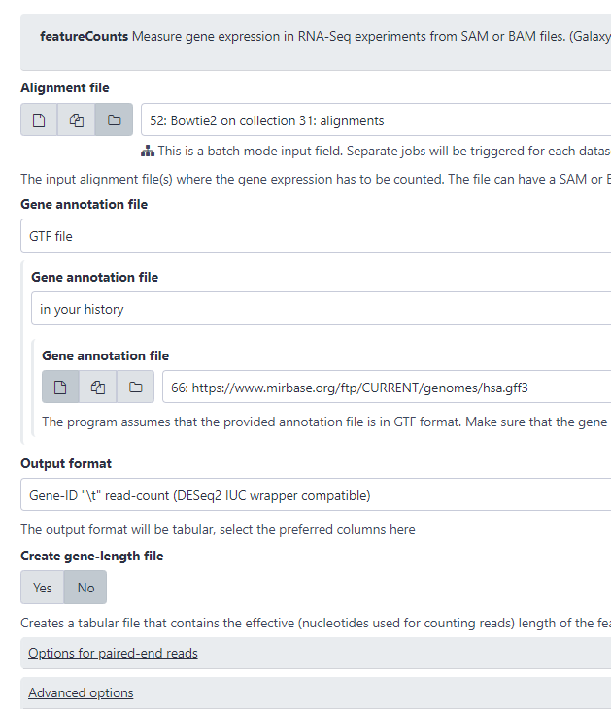
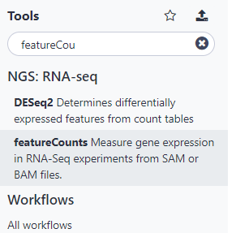
Step 6: Map and count miRNA reads with FeatureCounts
Select “dataset collection” Icon
Then select “Bowtie2 on collection…” from drop-down
Select “in your history”
Then select miRbase GFF file from drop-down

Slide 32
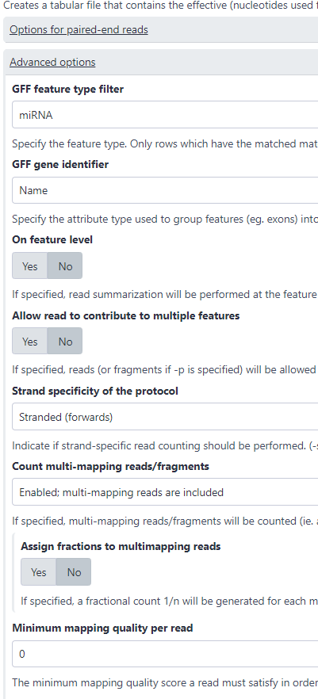
Step 6: Map and count miRNA reads with FeatureCounts
Change GFF feature type to “miRNA”
Change GFF gene identifier to “Name”
Change strand specificity to “Stranded (forwards)”
Enable multi-mapped read counting
Set minimum read quality to 0
(This is because of how bowtie2 deals with multi-mapped read)

Slide 33


Step 6: Map and count miRNA reads with FeatureCounts

Slide 34


Step 6: Map and count miRNA reads with FeatureCounts
Examine mapping statistics

Slide 35


Step 6: Map and count miRNA reads with FeatureCounts
Examine read count files

Slide 36


Step 7: Download read count files for further analysis
Download and unzip/extract raw read count files

Slide 37



Step 8: Differential expression analysis with DESeq2 in Galaxy
Re-upload raw read count files as individual files, instead of a collection

Slide 38




Step 8: Differential expression analysis with DESeq2 in Galaxy
Factor Name = CWD_Status
These 3 samples are “positive”
These 3 samples are “negative”

Slide 39


Step 8: Differential expression analysis with DESeq2 in Galaxy
Input files do not have a header

Slide 40

Step 8: Differential expression analysis with DESeq2 in Galaxy
Examine results file

Slide 41

Step 8: Differential expression analysis with DESeq2 in Galaxy
Examine plots

Slide 42
Part II: Downstream analysis in R (more advanced)
Raw read count processing
Normalization and differential expression analysis with DESeq2
Common data visualizations

Slide 43

R coding environment & R Studio
What is R?
“R is a programming language for statistical computing and graphics”
Download R from https://www.r-project.org/
Download R studio from https://www.rstudio.com/products/rstudio/download/
New to R? https://support.rstudio.com/hc/en-us/articles/201141096-Getting-Started-with-R

Slide 44


Set working directory in R Studio
The working directory lets R know where your files are saved, you simple specify the folder that will be used for the analysis. In this case it is the `analysis directory` folder provided in the tutorial.

Slide 45


Open R script files into R Studio
Files can be examined and opened in the “Plots and files” pane within R Studio. Open the provided R scripts by simply clicking on the file.

Slide 46

Download required R packages
An R package is a reproducible unit of R code that usually contains a set of pre-defined functions used to complete a particular type of analysis.
Scripts are opened in R studio. Individual lines of code can be run by pressing `ctrl + enter`

Slide 47

Script 1: Pre-processing raw read count files
Run each line of code by pressing `ctrl + enter`. Pay attention to what is happening in the console and environment. Files that are loaded in the `environment` of R studio can be examined by clicking on them.

Slide 48


Script 1: Pre-processing raw read count files
Input: (x6)
Output:
This script takes the 6 separate read-count files from feature counts and merges them together into a single matrix, which is then saved as a `.csv` file and can be examined in excel.

Slide 49

Script 2: Normalization with DESeq2
Run each line of code by pressing `ctrl + enter`. Pay attention to what is happening in the console and environment. Files that are loaded in the `environment` of R studio can be examined by clicking on them.
The DESeq2 R package is popular for differential expression analysis of RNAseq data. A full description of how to use DESeq2 can be found at http://bioconductor.org/packages/devel/bioc/vignettes/DESeq2/inst/doc/DESeq2.html

Slide 50

Script 2: Normalization with DESeq2
This plot illustrates the “negative binomial model of gene-fitted dispersion estimates” used by DESeq2 to normalize the data. This is a global normalization method that is used by other RNAseq analysis R packages such as edgeR.

Slide 51

Common data visualizations: PCA (Script 2)
Run each line of code by pressing `ctrl + enter`. Pay attention to what is happening in the console and environment. Files that are loaded in the `environment` of R studio can be examined by clicking on them.

Slide 52

Common data visualizations: PCA (Script 2)
Principle component analysis, or PCA, is a dimensionality reduction technique used to visualize variation in the data in 2-dimensions. It is often used to examine sources of variation in gene expression data.

Slide 53

Script 3: Differential expression analysis with DESeq2
Run each line of code by pressing `ctrl + enter`. Pay attention to what is happening in the console and environment. Files that are loaded in the `environment` of R studio can be examined by clicking on them.

Slide 54

Script 3: Differential expression analysis with DESeq2
Results file:

Slide 55

Common data visualizations: Volcano plot (Script 4)

Slide 56

Common data visualizations: Volcano plot (Script 4)
A volcano plot show statistical significance (p-value) versus magnitude (fold change) and can quickly show changes in large datasets

Slide 57

Common data visualizations: Heatmap (Script 4)

Slide 58

Common data visualizations: Heatmap (Script 4)
Heatmaps are commonly used to examine gene expression across samples. Hierarchical clustering of genes and samples can make it easier to identify patterns in the gene expression data.

Slide 59
Further analysis
Which genes are targeted by these miRNAs?
miRNA target prediction online tools:
http://carolina.imis.athena-innovation.gr/diana_tools/web/index.php?r=tarbasev8%2Findex
http://snf-515788.vm.okeanos.grnet.gr/
http://mirdb.org/
http://www.targetscan.org/vert_80/

Slide 60
Summary
Part I: Preprocessing in Galaxy
Assessing sequencing read quality with FastQC
Removing sequencing adapters with Cutadapt
Cleaning sequencing reads with Trimmomatic
Aligning to reference genome with Bowtie2
Mapping reads to miRNAs and counting with FeatureCounts
Part II: Downstream Analysis with R
Raw reads count processing
Normalization and differential expression analysis with DESeq2
Examples of common data visualizations

